Slide 1
Fluorescence Spectroscopy
Fluorescence spectroscopy or fluorimetry or spectro-fluorimetry is a technique to detect and analyze the fluorescence in the sample.
Fluorescence is the emission of light by a substance (fluor) that has absorbed light or other electro-magnetic radiation.
In this emission phenomenon, a beam of light (usually UV light) excites the electron in a molecule which moves from ground state to higher energy excited state.
When the electron falls back to the ground state, it emits fluorescence.

Slide 2
Absorbance/Fluorescence Spectroscopy
Fluorescence is more sensitive to environment than absorbance
Smaller amounts of material are required for fluorescence spectroscopy
Hence Fluorescence spectroscopy is of greater value than Absorbance spectroscopy.
Absorbance spectroscopy is simpler to perform

Slide 3
Information obtained from Fluorescence Spectra
Conformation
Binding sites
Solvent interactions
Degree of flexibility
Intermolecular distance
Rotational diffusion coefficient of macromolecules
With living cells fluorescence can be used to localize otherwise undetectable substance

Slide 4
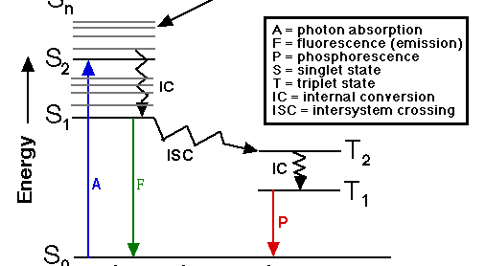
Jablonski diagram of Fluorescence excitation, radiative decay and nonradiative decay

Slide 5
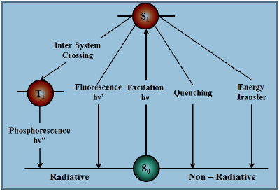
Theory of Fluorescence:
When a molecule absorbs light, an electron is promoted to a higher excited state (generally a
singlet state but may also be a triplet state). The excited state can get depopulated in several ways.
• The molecule can lose its energy non –radiatively by giving
its energy to another absorbing species in its immediate
vicinity (energy transfer) or by collisions with other species
in the medium.
• If an excited state triplet overlaps with the exited state
singlet, the molecule can cross over into this triplet state
This is known as inter system crossing
If the molecule then returns to the ground state singlet (T₁--S₀) by emitting light, the process is known as phosphorescence.
The molecule can partially dissipate its energy by undergoing conformational changes and relaxed to the lowest vibrational level of the excited state in a process called vibrational relaxation.
If the molecule is rigid and cannot vibrationally relax to the ground state, it then returns to the ground state (S₁-- S₀) by emitting light, the process is known as fluorescence.

Slide 6
Stokes Shift:
The difference between the wavelength of absorption maxima and the emission maxima.
Wavelength of absorbed radiation (having low wavelength, higher energy ) is denoted by (a) wavelength of emitted (fluorescence) radiation (having higher wavelength values and lower energy) denoted by (b)
Stokes shift = b-a.
Good results are achieved with the compounds having the greater Stokes shift. Greater the Stokes shift, lesser will be the interference as the excitation and the emission spectra do not overlap.

Slide 7
Fluorophores:
Chromophores which exhibit the phenomenon of fluorescence are called fluors or fluorophores (organic molecules of 20-100 Daltons).
Fluorescent molecules absorb the electromagnetic radiation in visible region and emit the radiation at a higher wavelength in the visible e.g., ethidium bromide (493 nm/620 nm).
Most commonly fluorescent molecules absorb the electromagnetic radiation in the UV range and emits in visible range. Example: green fluorescent protein (360 nm/508 nm).
Fluors have characteristics emission spectrum (fluorescence) or as well as characteristic absorbance spectrum which depends upon its structure and chemical environment.

Slide 8
Fluorophores (Contd.)
Intrinsic fluors: The native compound exhibits the property due to the presence of aromatic groups in amino acid side-chains in the case of proteins for example tyrosine, tryptophan and phenylalanine. Cofactors such as FMN, FAD and NAD also exhibit fluorescence.
Extrinsic fluors: Non-fluorescent compounds can be detected by coupling a fluorescent probe (or fluor). Examples are 1- Anilino-8-naphthalene suphonate, fluorescein (for protein), ethidium bromide and acridine orange (for DNA).

Slide 9
Disadvantages of Fluorescence Spectroscopy
Fluorescence is susceptible to pH, temperature and solvent polarity.
Whether a particular compound will fluoresce or not is the main problem being encountered.
Fluorescence quenching. This occurs when emitted fluorescence is lost to other molecules by collision interaction. Quenching is more in concentrated samples
To increase the sensitivity and accuracy of spectrofluorometer, very low concentrated samples are used which decrease the collisions and hence the quenching.
Many interfering materials such as detergents, filter paper and some tissues material may affect the fluorescence

Slide 10
Quantum efficiency
Quantum efficiency (Q) = quanta fluoresce/quanta absorbed or number of photons emitted/number of photons absorbed. It is independent of the excitation wavelength.

Slide 11
Spectrofluorimeter Instrumentation
Light Source: A high intensity light beam: Xenon Arc lamp , LASER
Monochromator: Diffraction grating is most common, Two monochromators are used one is excitation and another is emission
Detector: A sensitive Photocell. Single Channel (detects one wavelength at a time) or multichannel (detects all emitted wavelengths)

Slide 12
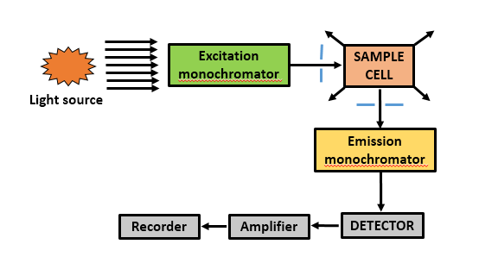
Spectrofluorimeter Instrumentation 90⁰ Illumination

Slide 13
Pre and Post Filter Effects
Pre-filter effects arises due to the absorption of radiation before reaching to the fluorescent molecule and
post-filter effects arises due to the decrease in fluorescence emitted by the fluorescent molecule before escaping the cuvette. These effects increase with the increase in sample concentration. The use of microcuvettes alleviates this effect to some extent.

Slide 14
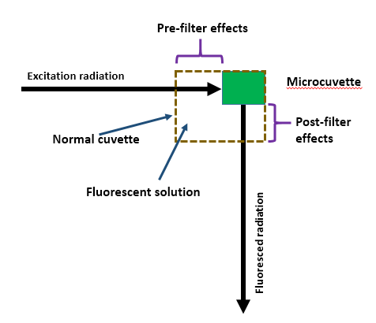
Pre-and post Filter Effect

Slide 15
Front face illumination
This type of illumination set up removes pre and post filter effects.
In front face illumination, cuvette with one optical face is used and the excitation and emission occur at the same face.
This set up is less sensitive than 90⁰ illumination

Slide 16
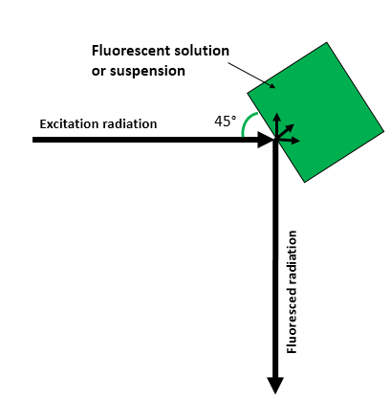
Front Face illumination

Slide 17
Applications
Fluorescent probes:
Probes are useful in both qualitative and quantitative detection.
It helps in the detection of biological compound which is present in very low concentration in a mixture.
They are applied to characterize folding intermediates and surface hydrophobicity

Slide 18
Protein and peptide structure
The intrinsic fluors such Trp, Tyr and Phe are present in the protein.
Proteins are generally excited at 280 nm and fluorescence is measured at 295 nm.
The fluorescence of folded protein is contributed by all individual aromatic amino acids present in it.
Among these, Trp exhibits strong fluorescence whereas Tyr and Phe exhibits less fluorescence.
The emission fluorescence of Trp is solvent dependent.
As the polarity of the solvent surrounding the Trp decreases, the fluorescence intensity of the Trp increase.

Slide 19
Protein and peptide structure (Contd)
Tyr emits fluorescence less than the Trp and its fluorescence is quenched by the Trp present in its vicinity.
Phe gives weak fluorescence and its fluorescence is only observed when both Tyr and Trp are absent.
Any conformational change in the protein therefore changes the absorbance.
Cofactors such as FMN, FAD, NAD exhibits the fluorescence and are also applied in the protein structural studies.
The binding and release of cofactors, inhibitors, substrates at sites close to the fluor, cause changes in the conformation and thus changes the fluorescence spectra.
It can also be used to study the denaturation and aggregation of protein and peptides.

Slide 20
Membrane Structure
The intensity fluorescence of a fluorescently labelled molecule is dependent upon the solvent/environment in which it is present.
Changes in the pH or solvent polarity affects the conformation and therefore structure changes can be monitored by the changes in the fluorescence.
Extrinsic fluor, ANS (1-Anilino-8-naphthalene sulphonate) probe can be used to monitor the changes in the mitochondrial membranes during energy transduction.
Hydrophilic and hydrophobic probes can be used for the membrane structure studies as they can orient themselves in hydrophilic and hydrophobic regions of the membrane and gives the information regarding the properties of the membrane and its surface.
Phospholipids containing 12-(9-anthroanoyl)-stearic acid and 2-(9-anthroanoyl)-palmitic acid into membranes yields the information about the thickness of the membrane.

Slide 21
Membrane Fluidity
For polarization measurement, polarizers are inserted into the excitation and emission light paths. With the excitation polarizer fixed, the emission polarizer can be rotated to measure the perpendicular (I_{i}) and parallel(I_{ii})
components of the fluorescence emission. The steady state polarization is defined as:
P= I_{i} -I_{ii}/I_{i} +I_{ii}
and an equivalent measure is the steady state anisotropy:
r= I_{i} -I_{ii}/I_{i} +2I_{ii}

Slide 22
Fluorescence recovery after photobleaching (FRAP)
FRAP technique is used for measuring the lateral diffusion in layers or thin membrane by fluorescent probes.
The sample under the study is fluorescently labeled and fluorescence in measured in sample and image is observed and captured with the help of optical microscope equipped with the timeline camera.
Light source is focused on the small patch of the sample and exposed to high intensity illumination (radiation) which causes photo bleaching of fluorescent probes.
Photo bleaching permanently lose the ability of fluor to fluoresce. This turns the patch in to dark color, fluorescence intensity in this area decreases and the image of the sample is continuously observed in the microscope.
With time, the adjacent and nearby fluorescing probes will slowly diffuse into the dark patch as Brownian motion proceeds. Depending upon the speed of diffusion and time, the dark patch will fluoresce again as the fluorescent probes moved in to the bleached area of non-fluorescent probes (beached probes).

Slide 23
FRAP (Contd)
This technique is very useful for studying the diffusion, fluorescently labeled phospholipids or proteins may be incorporated into a biological membrane and subjected to the similar treatment.
The motion of these phospholipids or proteins in the membrane can be studied by monitoring with low intensity radiation.
FRAP can also be used to study the protein binding in cell membrane, cell surface characterization, studying free energy in phospholipid layer.

Slide 24
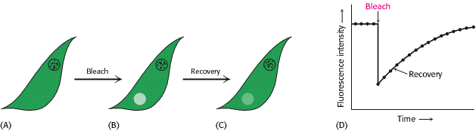
Lipids and Many Membrane Proteins Diffuse Rapidly in the Plane of the Membrane
Lipids and many membrane proteins are constantly in lateral motion, a process called lateral diffusion
The rapid lateral movement of membrane proteins has been visualized by means of fluorescence microscopy through the use of the technique of fluorescence recovery after Photobleaching.
The rate of recovery of fluorescence depends on the lateral mobility of the fluorescence-labeled component, which can be expressed in terms of a diffusion coefficient, D.
The average distance s traversed in time t depends on D according to the expression
Proteins vary markedly in their lateral mobility. Some proteins are nearly as mobile as lipids, whereas others are virtually immobile.
Figure: Fluorescence Recovery After Photobleaching (FRAP) Technique. (A) The cell-surface fluoresces because of a labeled surface component. (B) The fluorescent molecules of a small part of the surface are bleached by an intense light pulse. (C) The fluorescence intensity recovers as bleached molecules diffuse out of the region and unbleached molecules diffuse into it. (D) The rate of recovery depends on the diffusion coefficient.

Slide 25
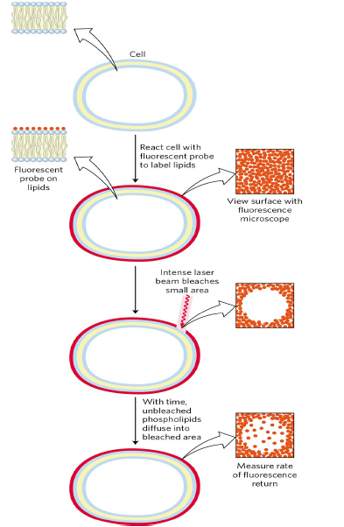
FIGURE: Measurement of lateral diffusion rates of lipids by fluorescence recovery after photobleaching
(FRAP). Lipids in the outer leaflet of the plasma membrane are labeled by reaction with a membrane-impermeant fluorescent probe (red) so that the surface is uniformly labeled when viewed with a fluorescence microscope. A small area is bleached by irradiation with an intense laser beam and becomes nonfluorescent. With the passage of time, labeled lipid molecules diffuse into the bleached region, and it again becomes fluorescent. Researchers can track the time course of fluorescence return and determine a diffusion coefficient for the labeled lipid. The diffusion rates are typically high; a lipid moving at this speed could circumnavigate an E. coli cell in one second. (The FRAP method can also be used to measurelateral diffusion of membrane proteins.)

Slide 26
Fluorescence resonance energy transfer (FRET)
Energy may be transferred from donor to acceptor flour through FRET or electronic energy transfer or dipole-dipole coupling.
For this to happen, the distance between the donor and acceptor is critical and both the fluors must be situated closely, there must be overlap between the donor fluorescence spectrum and acceptor fluorescence spectrum.
When the donor fluor is present alone, it will fluoresce. Placing the acceptor fluor in the vicinity of donor fluor, quenches the fluorescence emitted by the donor flour. This emitted radiation is sufficient for the electronic transitions in the acceptor flour, and thus emits the fluorescence of different intensity.

Slide 27
FRET (Contd)
Detects very small changes in distance
Detects molecular interactions in different systems, localization of metals in metalloproteins
Detects the interaction the between the proteins, measurement of conformational changes during binding of enzymes with substrate and receptors with ligand
Used to measure the distance between the two domains in the same protein, gives information about lipid rafts in the cell membranes

Slide 28
Fluorescence immunoassay (FIA)
FIA is a sophisticated technique and is used to detect the antigen and antibody interactions by using the fluorescent probes to label either antigen or antibody.
Antigen is detected by the binding of primary antibody. Excess of the primary antibody can be removed by washing. The antigen-antibody complex is then detected by the secondary antibody labelled with the fluor.
Excess of the secondary antibody can be removed by washing. The fluor is excited at a particular wavelength and the fluorescence is detected by the spectrofluorimetry.
High background fluorescence is the major disadvantage of this technique.
Two approaches are followed to reduce the background fluorescence and increases the sensitivity.
First, fluors having large stokes shifts should be preferred, example: europium chelates.
And secondly well designed fluorimeters, which delays the detection of emitted light and mean while the background fluorescence declines.

Slide 29
Fluorescence activated cell sorter (FACS)
FACS is a type of flow cytometer.
It is sorting of cells from a mixture of cells (cell suspension) into different compartments on the basis of fluorescence and light scattering emitted by the cells tagged with different fluor.
A cell suspension is allowed to pass through a narrow nozzle in a stream of liquid. This fast flowing stream of liquid is broken into droplets, each droplet containing a single cell and is achieved by vibration.

Slide 30
FACS (Contd.)
One cell in one droplet then pass through the fluorescence detection apparatus, which senses the fluorescence characteristic of the particular cell.
Additionally, each droplet also passes through an electric charging ring which give the charges to the droplet,
The charges depend upon the fluorescence emitted by the cell. These charged droplets then pass through an electrostatic deflection system, which senses the charges on the droplet and physically separate/deflects the droplets in to sequentially arranged containers.
This techniques is used in the counting the cells, separation of cells, purification of cells from a mixture.

Slide 31
Micro-spectrofluorimetry
A spectrofluorimter is equipped with microscope which enables to observe the binding of antibody to a single bacterial cell or subcellular organelle
Helps in the identification of cancerous cells from normal cell as they express different set of protein for which fluoresce labelled specific antibody can be applied.
Since some malignant cells have more nucleic acid content than do normal cell have, therefore these malignant cells take up more acridine orange dye which binds to the DNA and can be differentiated from the normal cells

